Slide 1


Security Testing Capabilities
October 2022
1 | ©2022, Clarium
©2022 Clarium All rights reserved.

Slide 2


Our Understanding
Problem Statement
To identify the threats in the "MGTCAP Application" and measure its possible vulnerabilities for the purpose of improving the security features. MGTCAP Application is being developed by "MGT Consulting" to market it as a Software as a Service (SaaS).
Our Approach to achieve MGT’s objectives
The product needs to be scanned for vulnerabilities
Ensure that there is no risk associated with vulnerabilities
Ensure data is protected in multi-tenant environment
Ensure hosted environment is capable of handling cyber security threats and attacks.
Do security code review and scanning
Identify security threats and vulnerabilities by Manual Testing
Conduct Penetration Testing
Generate Report, Risk for Vulnerabilities
Remediation for Vulnerabilities
Future State
Future State
Expectations
Security Approach
Target End State
Vulnerable free production ready product

Slide 3
Our approach to Software Security Assurance
Understanding the application flows
Understand Confidentiality, integrity & availability requirements
Tools installation and configuration
Vulnerability assessment after deployment
Reports
Suggest remediation / best practices for identified vulnerabilities
SCA
Security
Discovery Phase
Security Architecture & Design Review
Construction & Security code review
Security Testing
Expert
Assessment and Remediation
1
5
Understanding Authentication-> role->Functionality->Data
Threat Modelling analysis
Deployment & Infrastructure – Review
Secure Design practice Review
PII verification
2
Manual and Automated Security Testing
Identify risk with vulnerability
4
3
Automated & Manual Code Review
Secure Coding practice as pipeline

Slide 4
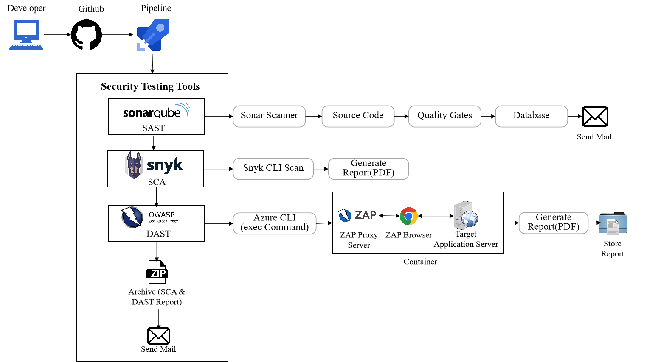
Approach - Security Code Review
SAST
DAST
SCA
Clarium advocates Secure Development Lifecycle instead of Vanilla SDLC
Clarium embed’s Security in Software Construction stage itself via Pipeline

Slide 5
Manual Security Testing - What is covered
Different types of Security Testing
Authentication Testing
Authorization Testing
Testing Audit Trails
Testing Session Management
Data Security Testing
Testing for Client-side attacks
Testing Data validation
Buffer Overflow Testing
Configuration Testing
Denial of Service Testing

Slide 6
Expert Assessment
Expert Assessment
Web Application Penetration Testing – Testers behave like hackers
Identify publicly exposed components like firewalls, routers, DNS
Identify loopholes that can lead to the theft of sensitive data
PII and Privacy Compliance Review – GDPR and CCPA compliance
Review how the PII data is collected, stored, processed and erased

Slide 7
MGT Security Testing
Pre-requisite From MGT Consulting
Infrastructure to execute security testing
Access to Infrastructure
On-boarding a DevOps Engineer
Access to codebase
License purchase of appropriate tools
Security Testing Activities From Clarium Tech PVT LTD
Prepare scope, test plan and test cases for manual security testing.
Perform manual security testing (Medium risk, High risk, Very High Risk)
Perform Dynamic Application Security Testing (DAST) using appropriate tools
Perform Static Application Security Testing (SAST) using appropriate tools
Provide remediation/ best practices and highlight risk for identified defects/ vulnerabilities
Perform Software Composition Analysis (SCA) using appropriate tools
Perform application and network penetration testing
Perform PII data compliance review

Slide 8
Thank You

